Slide 1
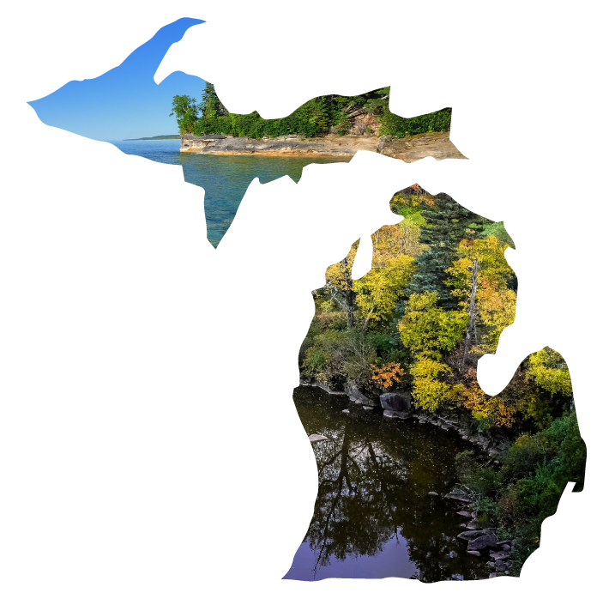
SENIORS!
Unlock money for college with the Michigan Achievement Scholarship!

Slide 2
QUALIFYING GRADS COULD GET
An associate degree or skill certificate
UP TO
UP TO
$27,500
$4,000
Tuition-free
for a 4-year private or public university
for a career training program
at a community college
Notes:
Are you planning to attend a Michigan community college, university or career school? You may qualify for thousands of dollars in scholarships!

Slide 3
Community College Guarantee
Earn your associate degree or skill certificate TUITION-FREE at your local community college!
(Or get community college tuition covered before transferring to a university.)
Please note: The Community College Guarantee covers in-district tuition, contact hours and mandatory fees.
Notes:
Interested in earning a skill certificate or associate degree? Or are you planning to attend a community college before transferring to a four-year university? The new Community College Guarantee may be for you! It offers tuition-free community college at eligible in-district schools.

Slide 4
Community College Guarantee
All Michigan high school seniors are eligible, no matter your GPA or household income!
Plus, if you receive the Federal Pell Grant, you’re eligible for an extra $1,000 that can be used toward additional college costs.
Applying is as easy as filling out your FAFSA!
Notes:
All Michigan high school seniors are eligible for the Community College Guarantee! There are no GPA or income requirements.
Plus, if you receive the Federal Pell Grant, you’re eligible for an extra $1,000 to help pay for living expenses like books, transportation and rent.
All you have to do to apply is complete the 2025-2026 FAFSA.

Slide 5
Michigan Achievement Scholarship 4-year pathway
Get up to $27,500 for college at a public or private university through the Michigan Achievement Scholarship!
Notes:
Want to earn a bachelor’s degree? The Michigan Achievement Scholarship could be for you! It offers up to $27,500 in college scholarships for eligible public or private universities in Michigan.

Slide 6
Michigan Achievement Scholarship 4-year pathway
Odds are, you’re eligible.
7 out of 10 graduating high school seniors may qualify, no matter your GPA or athletic abilities!
Just complete your FAFSA to apply!
Notes:
You don’t need to be a stellar student or all-star athlete to qualify for the Michigan Achievement Scholarship. And there’s no application essay required.
You won’t know if you’re eligible unless you fill out your FAFSA!

Slide 7
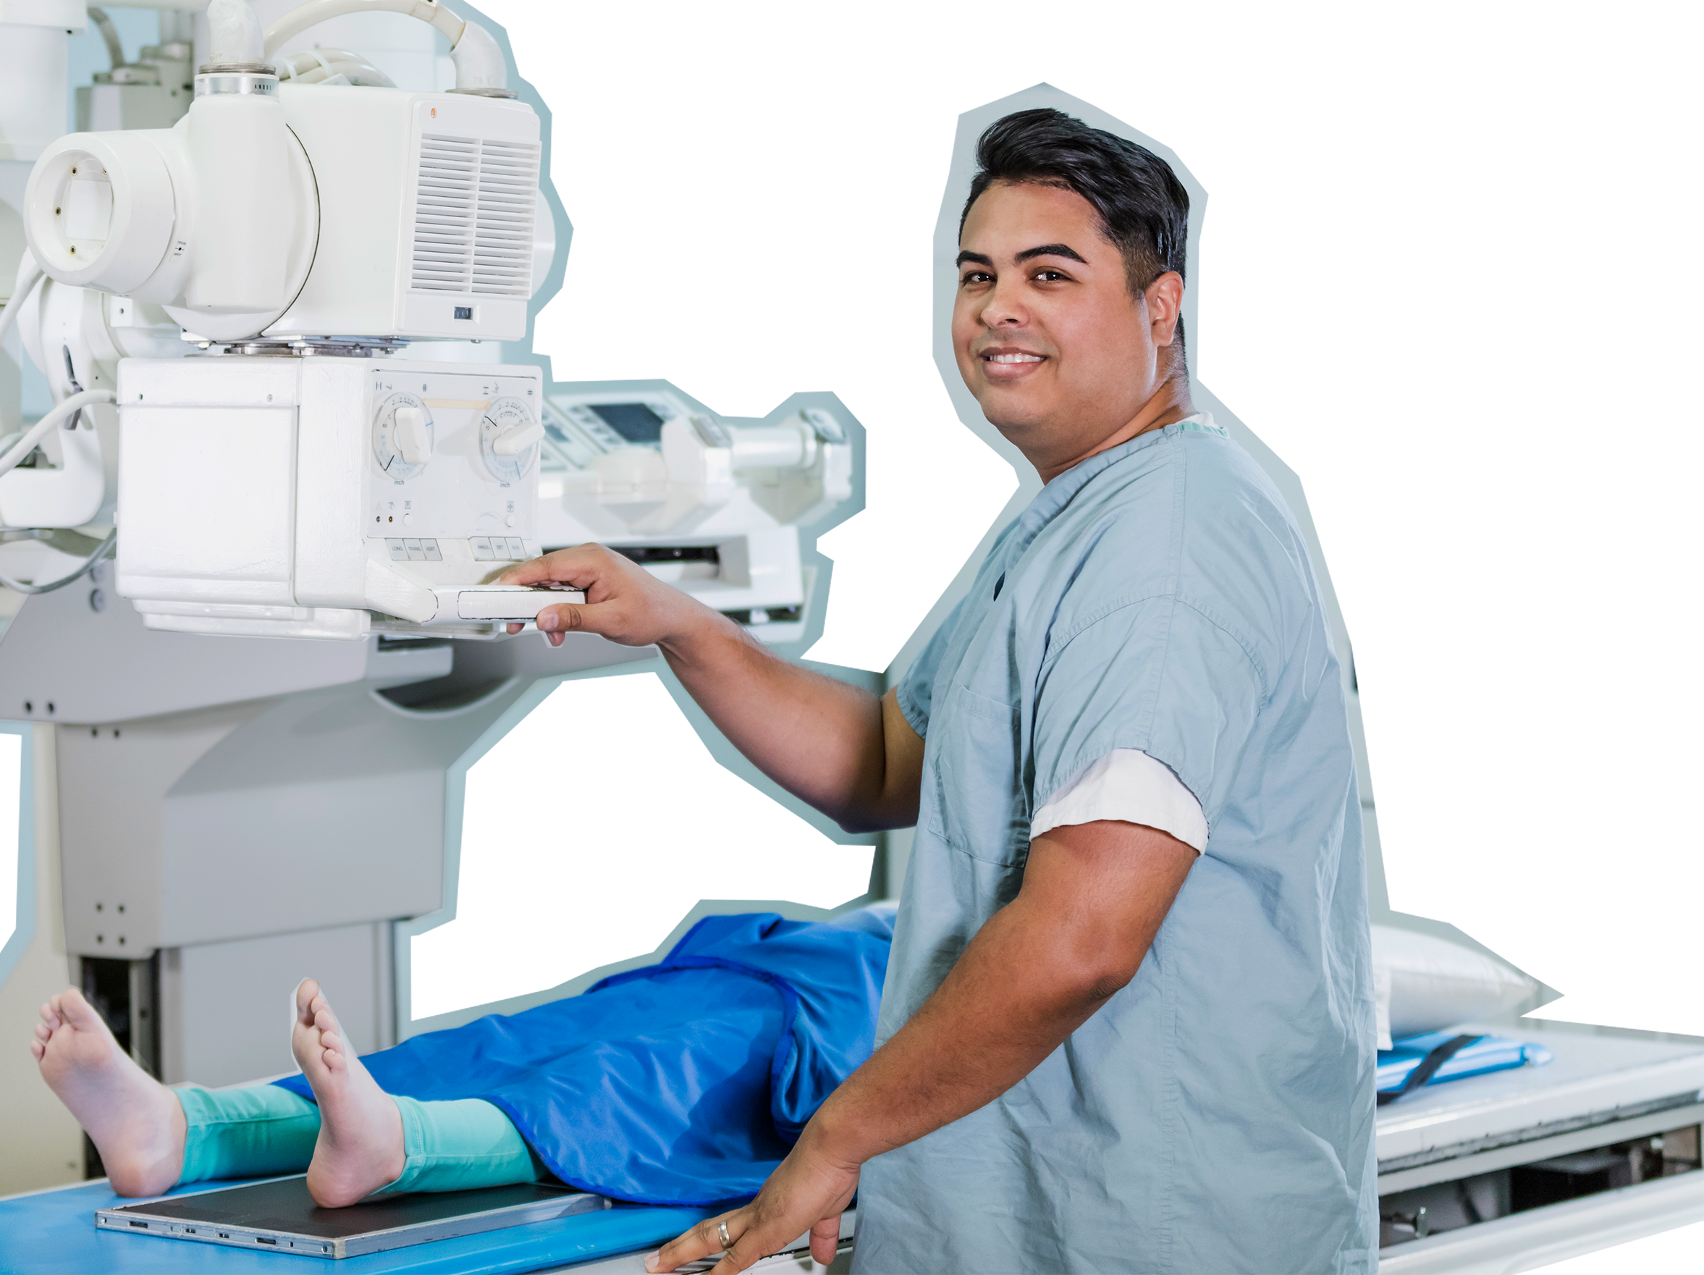
Michigan Achievement Skills Scholarship Career Training
Get up to $4,000 for a career training program!
Notes:
The Michigan Achievement Skills Scholarship might be right for you if you’d like to develop your skills in a career training program. If you qualify, you could receive up to $4,000 for career school.

Slide 8
Michigan Achievement Skills Scholarship Career Training
To apply:
Choose an eligible career training provider.
Complete your application through the MiSSG student portal.
1
2
Notes:
To apply for the Michigan Achievement Skills Scholarship, just pick an eligible career training provider and complete your application through the MiSSG student portal.

Slide 9
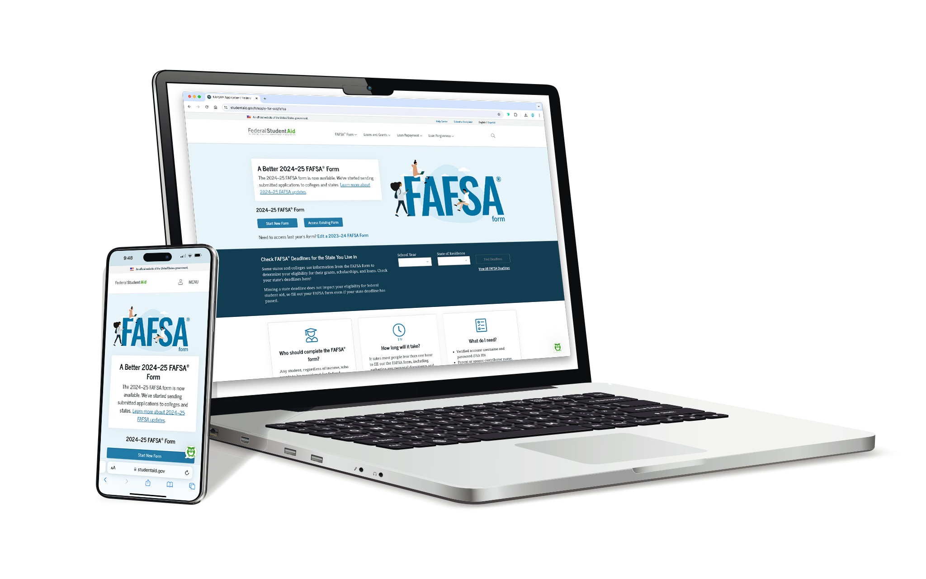
Complete your FAFSA to get started.
it’s easier than ever. Seriously.
In less time than it takes to scroll on TikTok, you could get money for college or career training!
Notes:
Even if you don’t know what your future plans are, start by filling out the FAFSA. It doesn’t commit you to anything; it’s just the first step to seeing what funding is possible.

Slide 10
3 Steps to filling out the FAFSA
1
Create your FSA ID.
2
Ask your parents to create their own FSA IDs.
3
Fill out the FAFSA with your parents. It takes most LESS THAN 15 minutes!
Note: It takes three to five days for your FSA ID to process.
Notes:
You’ll need your Social Security number and email address to create your FSA ID. It takes about three to five days for your FSA ID to be activated and you’ll need an active FSA ID to complete your FAFSA.
Your parents and any other contributors will also need their Social Security numbers and email addresses when creating their FSA IDs.

Slide 11
YOU’VE GOT THIS!
Fill out the FAFSA today!
mi.gov/ACHIEVEMENT
Notes:
Don’t miss out on money for college!
If you need any help completing the FAFSA or planning for college or career school, I’m here! Just swing by my office/make an appointment.

