Slide 1
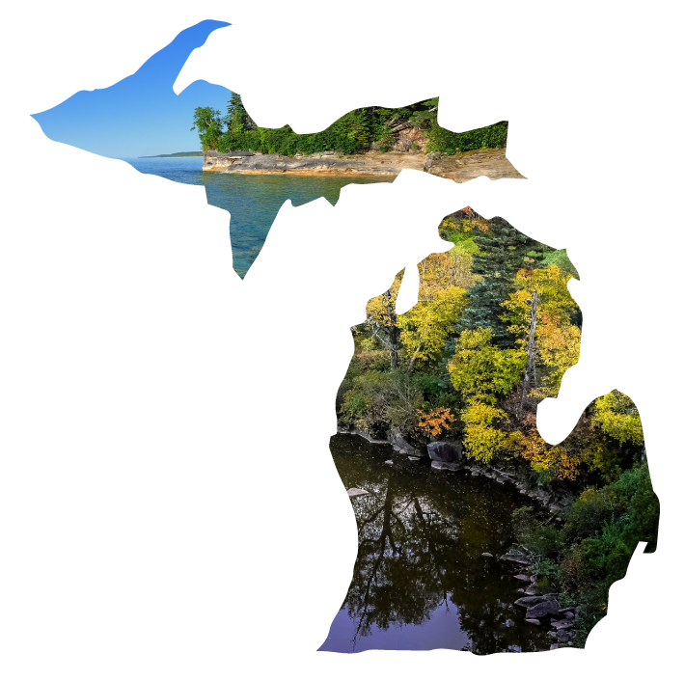
SENIORS!
Unlock money for college with the Michigan Achievement Scholarships!

Slide 2
QUALIFYING GRADS COULD GET
Are you planning to attend a Michigan community college, university or career school? You may be eligible for thousands of dollars in scholarships!
An associate degree or skill certificate
UP TO
UP TO
$4,000
$27,500
Tuition-free
for a career training program
for a private or public university
at a community college

Slide 3
Community College Guarantee
Earn your associate degree or skill certificate TUITION-FREE at your local community college!
(Or get community college covered before transferring to a university.)
Please note: The Community College Guarantee covers in-district tuition, contact hours and mandatory fees.

Slide 4
Community College Guarantee
All Michigan high school seniors are eligible, no matter your GPA or household income!
Plus, if you receive the Federal Pell Grant, you’re eligible for an extra $1,000 to help pay for living expenses.
Applying is as easy as filling out your FAFSA!

Slide 5
Michigan Achievement Scholarship 4-year pathway
Want to earn a bachelor’s degree?
Get up to $27,500 for college at a public or private university through the Michigan Achievement Scholarship!

Slide 6
Michigan Achievement Scholarship 4-year pathway
Odds are, you’re eligible.
7 out of 10 graduating high school seniors may qualify, no matter your GPA or athletic abilities! And there’s no application essay required.
Just complete your FAFSA to apply!

Slide 7
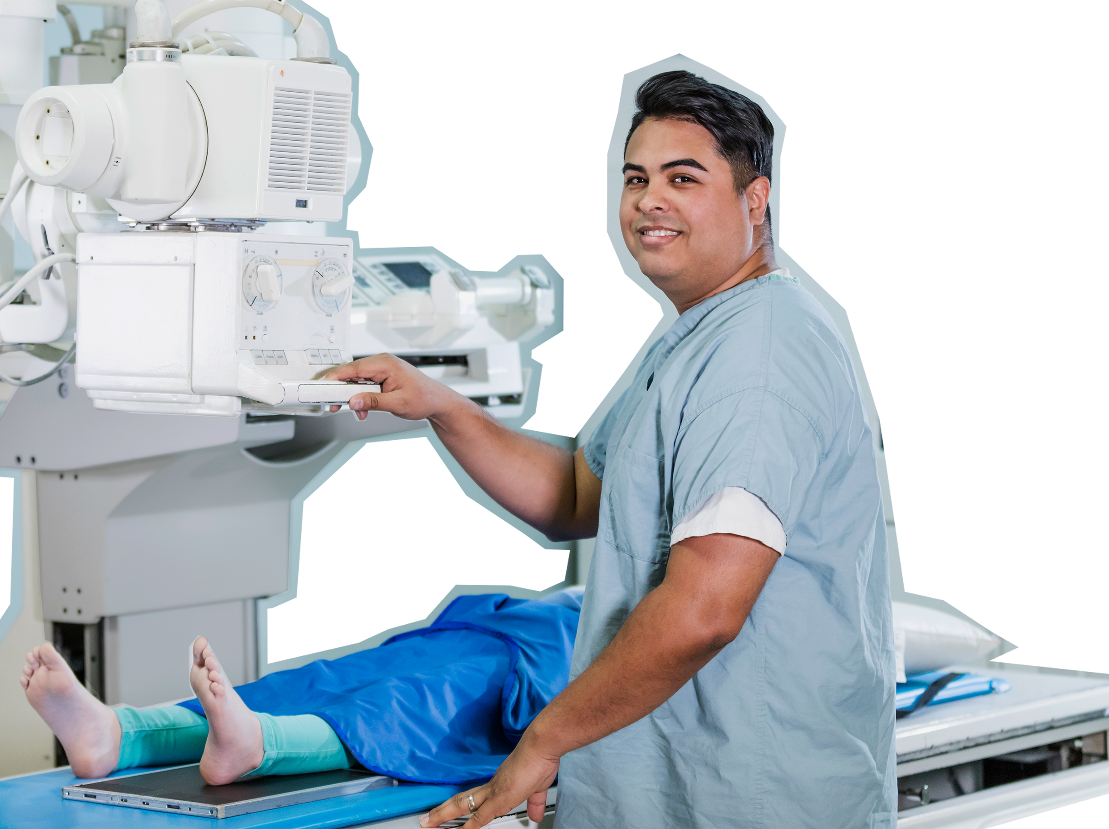
Michigan Achievement Skills Scholarship Career Training
Get up to $4,000 for a career training program!

Slide 8
Michigan Achievement Skills Scholarship Career Training
To apply:
Choose an eligible career training provider.
Complete your application through the MiSSG student portal.
1
2

Slide 9
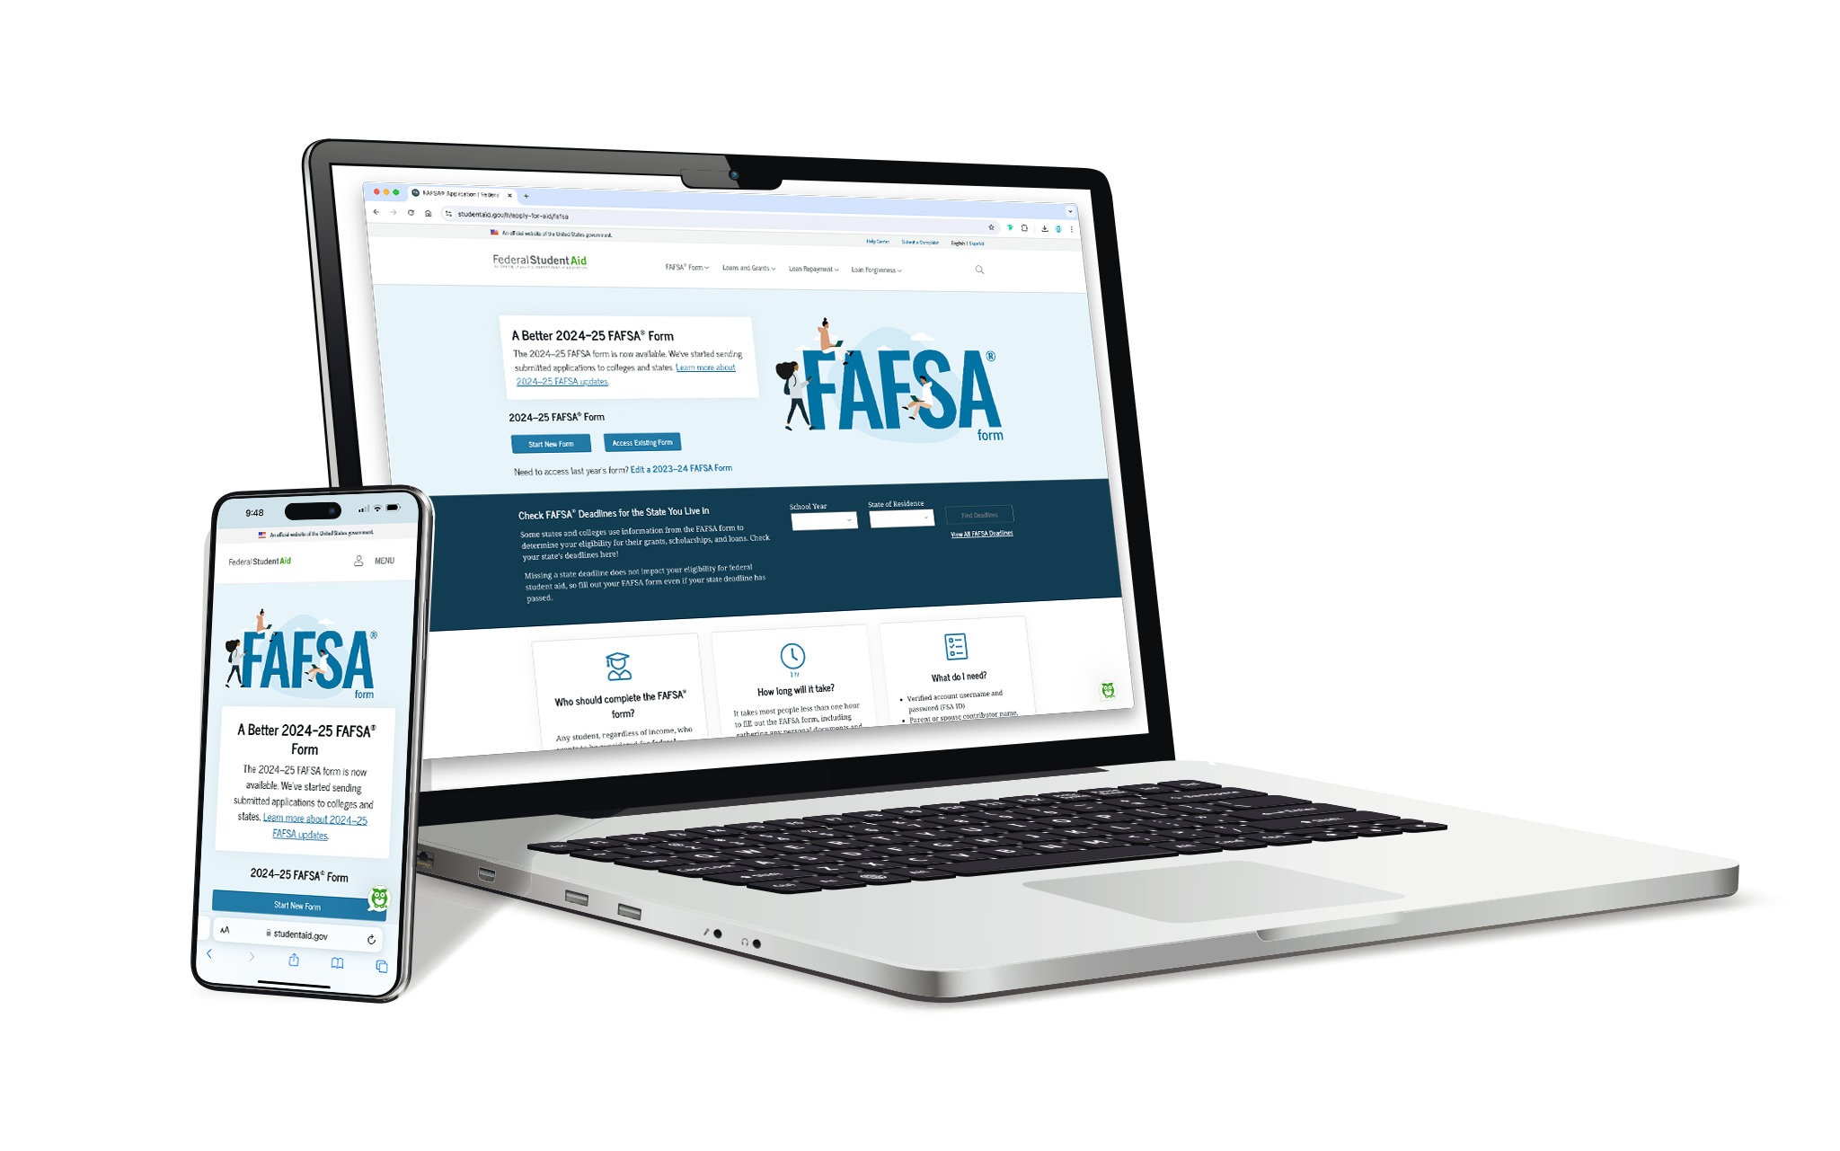
Complete your FAFSA to get started.
it’s easier than ever. Seriously.
In less time than it takes to scroll on TikTok, you could get money for college!
It’s worth completing, even if you’re unsure of your future plans. Filling out the FAFSA doesn’t commit you to anything. It’s simply the first step to seeing your funding options.

Slide 10
3 Steps to filling out the FAFSA
1
Create your FSA ID at michigan.gov/ mistudentaid/students-families/fafsa-resources.
You’ll need:
Your Social Security number
Your email address
2
Ask your parents to create their own FSA IDs.
3
Fill out the FAFSA with your parents. It takes most LESS THAN 15 minutes!
It takes about three to five days to get an FSA ID and you must have one before you can complete your FAFSA.

Slide 11
YOU’VE GOT THIS!
Fill out the FAFSA today!
mi.gov/ACHIEVEMENT

