Slide 1
COMPLETING
THE FAFSA
Notes:
Welcome! Ready to fill out your FAFSA?

Slide 2
FAFSA OVERVIEW We’ll answer:
What is the FAFSA?
What info is required?
What do you need to do before filling out the FAFSA?
Who fills out the FAFSA?
What can you expect?
What types of funding does it unlock?
What happens after submitting your FAFSA?
Notes:
We’ll walk you through everything you need to know!

Slide 3
WHAT IS THE FAFSA?
The FAFSA is the Free Application for Federal Student Aid.
The form is used by colleges and career training programs to figure out how much financial aid you’re eligible for.
It could include free money for college or career training (like grants and scholarships), work-study funds and loans. It takes most families 30 minutes or less to complete.
Notes:
The Free Application for Federal Student Aid (or FAFSA) is the first step to receiving financial aid. Filling out the form could mean thousands of dollars in money for college or career training.

Slide 4
Student Aid Index (SAI)
Your SAI is the number used by colleges to determine how much federal student aid you may be eligible to receive based on your family’s financial need. It’s calculated using the info provided on your FAFSA.
What impacts your SAI?
Student and parent income
Assets
Amount of taxes paid
Notes:
The FAFSA helps determine your Student Aid Index (or SAI). This number is used to measure a student’s ability to pay for college and their financial aid eligibility.
The SAI is sent directly to state agencies and the colleges and universities included on your FAFSA. It’s used by some schools to determine institutional aid.

Slide 5
WHY FILL OUT THE FAFSA?
The FAFSA is your first step to accessing financial aid that can help you afford college or career training. Submitting yours doesn’t lock you into anything. You don’t have to know your plans or commit to accepting financial aid to see what doors the FAFSA could open for you.
The FAFSA unlocks:
Grants and scholarships (That’s free money for college that you don’t have to pay back!)
Student loans
Work-study funds
Notes:
The FAFSA opens the door to more than just loans. You could also be eligible for work-study funds and free money for college (such as grants and scholarships).
You don’t have to have your plans fully mapped out. Completing the FAFSA doesn’t lock you into anything; it just shows you what funding is possible.

Slide 6
Dependency statuses:
Dependent students are typically:
Under 24 years old
Unmarried
Without children or other dependents
Independent students may be one or more of the following:
24 years old or older
Live separate from their parents
Married
A parent
A veteran or member of the armed forces
An emancipated minor
A graduate student
Notes:
You may not be the only person who needs to complete the FAFSA. Additional contributors may include biological or adoptive parents, a stepparent or spouse. Their federal tax information will be used to determine eligibility for federal student aid. Your dependency status determines whose information you need to report on your FAFSA.
Dependent students need to include parent info, while independent students do not. Unsure if you’re a dependent or independent student? We can help you figure it out!

Slide 7
FAFSA CONTRIBUTOR INFORMATION
What is a contributor?
A contributor is anyone required to provide information, a signature and consent and approval to have their federal tax information transferred directly into the FAFSA form.
Notes:
The student may not be the only person who needs to complete the FAFSA. Additional contributors may include biological or adoptive parents, a stepparent or the student’s spouse. Their federal tax information will be used to determine eligibility for federal student aid. Your dependency status determines whose information you need to report on your FAFSA.
Dependent students need to include parent info, while independent students do not. Unsure if you’re a dependent or independent student? We can help you figure it out!

Slide 8
PARENT(S) MARITAL STATUS | FAFSA ACTION
Parents are married to each other | Need both parents’ information
Parents are legally separated/divorced | Use information from the parent who provides the most of financial support
Parent is remarried to stepparent | If remarried parent has custody, use both parent and stepparent income
Parents were never married, not living together | Use information from the parent who provides the most of financial support
Parents were never married, but are living together | Use both parents’ information
Parent Info and Invitation
If you’re a dependent student, you’ll need to invite one or more parents to provide information on your FAFSA.
Notes:
Most students are dependents. Dependent students need to include parent information on their FAFSA and invite them to complete their portion of the form.
Students will have to enter some basic personal info about their parents, including full names, dates of birth, Social Security numbers and email addresses. This is used to invite the parents to the student’s FAFSA form.

Slide 9
What if your parent isn’t a U.S. citizen?
Parents and other contributors don’t need to be U.S. citizens.
Their citizenship doesn’t affect your financial aid eligibility.
If they don’t have a Social Security number (SSN), just check the box that says they don’t have one and leave the SSN field blank.
Notes:
You can still complete your FAFSA if your parents aren’t U.S. citizens.

Slide 10
DO THIS BEFORE starting your FAFSA
Create StudentAid.gov accounts for all contributors (including you and your parent) at StudentAid.gov. You’ll need your:
Social Security number
Email address
You must have active StudentAid.gov
accounts to complete your FAFSA.
Notes:
If you haven’t created your StudentAid.gov accounts yet, we can help you do that today.

Slide 11
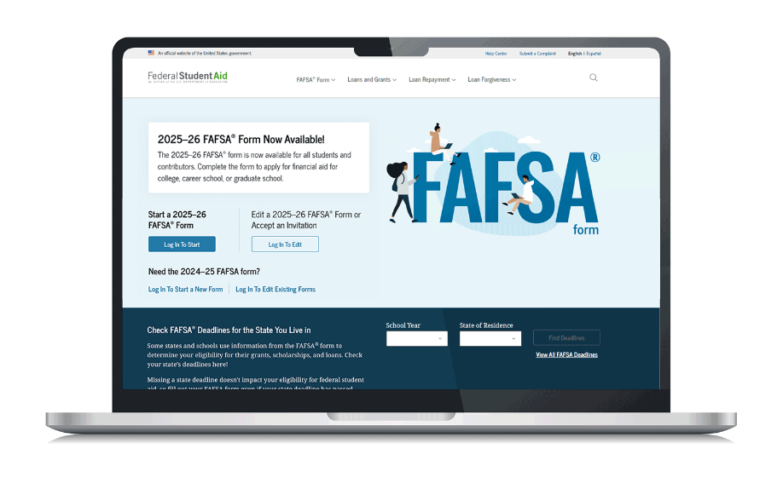
What to expect when completing the FAFSA
You and your parents will be asked questions about:
Basic personal and contact information
Demographics
Personal circumstances and living situations
Consent to use IRS information
Finances
Notes:
The FAFSA will ask you about your personal information and circumstances, finances and which colleges or universities you’re considering attending. You’ll also be asked for consent to use your IRS information.
If this seems overwhelming, don’t worry! The FAFSA uses skip logic to walk you through the form and only asks questions relevant to you. For most people, it takes less than 30 minutes to complete.

Slide 12
STARTING YOUR FAFSA
Take these first steps to completing your FAFSA:
Log in to FAFSA.gov using your StudentAid.gov account (account username and password)
Select your role: Student or parent
Review the FAFSA onboarding before diving into the questions
Notes:
You’ll have a chance to get more FAFSA info before answering the questions on the form.
FAFSA onboarding covers:
FAFSA overview
Student vs. parent role
Types of questions asked
What to expect after submitting the FAFSA

Slide 13
Basic Personal Information and Demographics
PERSONAL INFO
Name
Date of birth
Social Security number
Contact info (phone, email)
Physical address
State of legal residence
Demographics
Gender
Race and ethnicity
Parental education status (student only)
Parent killed in the line of duty (student only)
High school completion status
Notes:
Students and parents will be asked basic identifying information.

Slide 14
Filling out the FAFSA
Personal Circumstances and Dependency Status
To determine your dependency status, you may be asked about your:
Marital status
College or career school plans
Military status
Foster care history
Experiences of homelessness or risk of experiencing homelessness
Unique circumstances contacting your parents
Notes:
Students will be asked about their personal circumstances and living situation. Their answers will determine whether they’re considered dependent or independent.
Note: If a parent completes the form first, they will need to answer these questions from the student’s perspective.

Slide 15
Filling out the FAFSA
Consent to Use IRS Information
All contributors will be asked to let the FAFSA pull their stored tax info directly from the IRS.
This lets you skip most of the income tax questions on the form and complete the FAFSA in less time. If consent isn’t given, you will not be eligible for federal financial aid.
Notes:
Sharing your IRS info helps reduce the number of questions on the form. Once you give consent, your federal tax information is transferred directly into the FAFSA form from the IRS. Then, you’ll have a few more financial questions to answer in the Student Financials and Parent Financials sections.

Slide 16
Filling out the FAFSA
Student Finances
You’ll be asked about your:
2023 tax return
Assets
Bank account balances
Investments
Net worth of business and farms
Notes:
Parent finances are used to calculate the financial aid of dependent students.
Federal benefits received may include federal housing, free or reduced price of school lunch, Medicaid or other benefits.
Assets refer to your current bank account balances and the net worth of your investments, businesses and investment farms.

Slide 17
Filling out the FAFSA
Parent Financials
Your parents will be asked about their:
2023 tax return
Tax filing status
Federal benefits received
Family size
Number of family members in college
Assets

Slide 18
Filling out the FAFSA
Untaxed Income
If your parents or other contributors earn mostly untaxed income (like cash or Social Security benefits), you can still fill out the FAFSA. Here’s how:
Report estimated earnings in the “untaxed income” section.
Be honest and accurate, and if you’re asked for verification, have documents like bank or benefits statements ready.
Don’t stress. The FAFSA is here to help students pay for their next chapter, not penalize families who have not paid taxes.
Notes:
Does your family earn mostly untaxed income? Good news! You can still fill out the FAFSA.

Slide 19
Filling out the FAFSA
College Selection
Choose up to 20 schools to add to your FAFSA!
To select colleges or career schools you’d like to receive your FAFSA information, search by the state, city and/or school name. These are schools you might be interested in applying to.
You can add or remove schools after the FAFSA is
submitted, as long as you don’t go over 20 schools.
Notes:
The colleges or career training programs you include on your form will receive your FAFSA information.
å
Students should add any school they plan on applying to, or that they have applied to (even if they haven’t been accepted yet).

Slide 20
Filling out the FAFSA
Review Page and Signature
Check all responses before signing and submitting your FAFSA.
To edit responses:
Click the question’s hyperlink to be taken to that page
Make any necessary edits
Be sure to sign your FAFSA!
You and your parents/contributors must sign and submit your portion of the form for it to be considered complete and ready to process.
Notes:
The review page shows all responses given. Once you’ve completed your review and made necessary edits, continue to the signature page.
When you sign the form, you’re acknowledging the terms and conditions of the FAFSA. After agreeing and signing, you can submit your section.
You’ll receive a confirmation email with a page detailing your confirmation date, estimated Student Aid Index and next steps.

Slide 21
What happens after completing the FAFSA
Checking Your Status
See the status of your FAFSA form by:
Logging in to FAFSA.gov
Finding your application status under “My Activity,” which shows up after you’ve logged in and have started or completed a FAFSA form.
Notes:
You can check the status of your FAFSA form after it’s submitted.

Slide 22
Your Status will be one of the Following
Draft | Your section of the FAFSA form is incomplete.
In Progress | You provided your consent, approval and signature for your section of the FAFSA form, but it has not been submitted yet.
In Review | Your FAFSA form was submitted but hasn’t been processed yet.
Action Required | You are missing your consent and approval or signature. Or the FAFSA form was processed but a correction is needed.
Processed | Your application was processed successfully. No further action is needed.
Closed | Your FAFSA form was never submitted and can no longer be submitted because the federal FAFSA deadline passed.
What happens after completing the FAFSA

Slide 23
What happens after completing the FAFSA
Financial Aid Offers
You’ll get financial aid offers from all schools listed on your FAFSA if you’ve been accepted for admission.
Note: The offers could be sent electronically or by postal mail.
Notes:
After you submit the FAFSA, each school’s financial aid office will prepare an offer summarizing all available aid, including the cost of attendance and various types of funding (like grants, scholarships, loans and work-study).
Review and compare these offers, as they may vary by school. Consider the net cost, which is the cost of attendance minus grants and scholarships. (Remember, grants and scholarships are free money for school that doesn’t have to be repaid).
Be sure to accept financial aid by the school’s deadline.

Slide 24
What happens after completing the FAFSA
What if your family’s financial situation changes after submitting your FAFSA?
If your family’s financial situation has changed — like a job loss or unexpected medical expenses — you can request a special circumstances review.
After submitting the FAFSA, reach out to the financial aid office at your chosen school to explain the change, and be ready to provide proof (like termination letters or medical bills).
Notes:
Students whose circumstances change after submitting their FAFSA can request a “Professional Judgment” from their financial aid office, which may allow a student’s financial aid offer to be reevaluated.

Slide 25
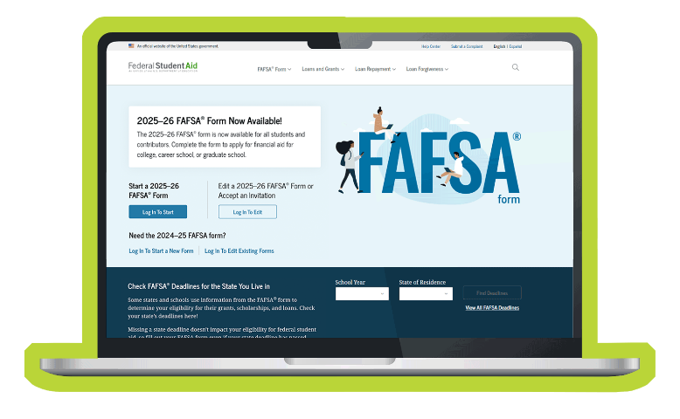
You’ve Got THIS!
Fill out the FAFSA today! FAFSA.gov
Notes:
Welcome! Ready to fill out your FAFSA?

