Slide 1



SOCIAL SERIES
FAFSA COUNTDOWN

Slide 2
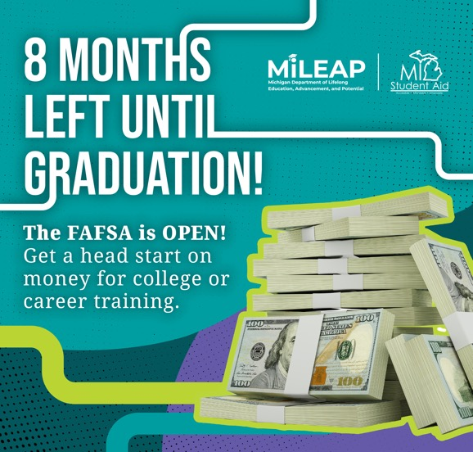
GRAPHIC:
Post 1 — October
Post Copy:
The FAFSA is officially OPEN! 🎉 Seniors can get a head start on planning for what comes after graduation by filling it out now. Completing the FAFSA can unlock scholarships, grants and other financial aid for college or career training, including the Michigan Achievement Scholarship. 💰 Get started at FAFSA.gov.

Slide 3

GRAPHIC:
Post 2 — NOVEMBER
Post Copy:
Senior year moves fast! ⏰ Get ahead by completing the FAFSA now. Completing the FAFSA is an important step toward accessing scholarships, grants, work-study funds and other financial aid for college or career training. The sooner you get started, the sooner you can see what may be available to help pay for your future. 💰 Fill out the FAFSA today at FAFSA.gov.

Slide 4

GRAPHIC:
Post 3 — DECEMBER
Post Copy:
Winter break is almost here — time to rest, recharge and fill out your FAFSA! Whether you’re considering community college, a university or career training, completing the FAFSA can help you find out what scholarships, grants and other financial aid you may qualify for. Give your future self a gift and fill out the FAFSA at FAFSA.gov. 🎁

Slide 5

GRAPHIC:
Post 4 — JANUARY
Post Copy:
🎉 Start the new year by unlocking FREE MONEY for college or career training — including scholarships like the Michigan Achievement Scholarship. 💰 Don’t wait. ⏰ Fill out the FAFSA today at FAFSA.gov.

Slide 6

GRAPHIC:
Post 5 — FEBRUARY
Post Copy:
Completing the FAFSA doesn’t lock you into anything. It just shows you what’s possible — including qualifying for scholarships, grants, work-study funds and loans. 💵 Get started today by creating StudentAid.gov accounts at FAFSA.gov.

Slide 7
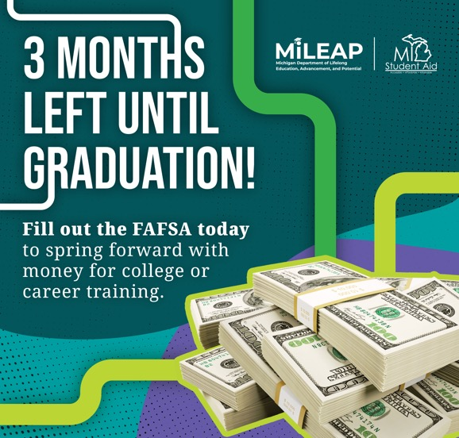
GRAPHIC:
Post 6 — MARCH
Post Copy:
Spring into the future with the FAFSA. 🌷 It takes most families just 30 minutes or less to complete. 🕥 Get on the path to unlocking scholarships (like the Michigan Achievement Scholarship), grants, work-study funds and loans. 💰 Fill out your FAFSA now at FAFSA.gov.

Slide 8
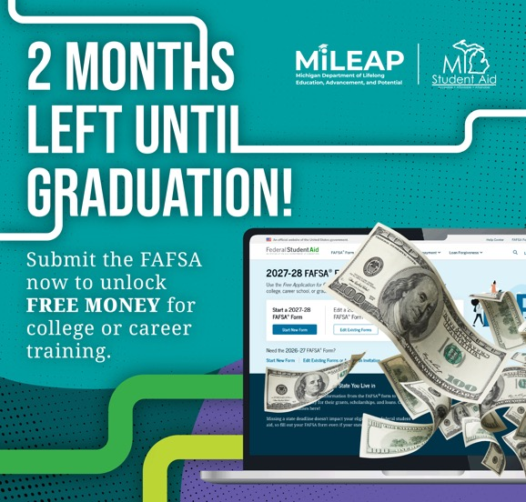
GRAPHIC:
Post 7 — APRIL
Post Copy:
Think the FAFSA is just loans? 🤔 Think again! It also opens the door to FREE MONEY for college or career training. 💰 Fill out the FAFSA today to get access to scholarships (like the Michigan Achievement Scholarship), grants and more!

Slide 9

GRAPHIC:
Post 8 — MAY
Post Copy:
Graduation is right around the corner. 🎓 Now’s the time to complete the FAFSA and lock in money for community college, university or career training by filling out the FAFSA! If you don’t, you could miss out on thousands. 💵 Get started now at FAFSA.gov.

